Slide 1
SELF BALANCING ROBOT

Slide 2
MEMBER
Đặng Long Bảo | 20145400
Đoàn Minh Đức | 20145411
Vũ Xuân Hiệp | 20145413
Võ Thanh Bình | 20145025
LECTURER
M.S. Nguyễn Trung Hiếu
SUBJECT
Vehicle Automatic Control Systems

Slide 3
TABLE OF CONTENTS
01
02
03
04
05
Introduction
Theorical basis
Simulation
Experiment
Conclusion

Slide 4
01
INTRODUCTION
1.1 Introduction
1.2 Objective
1.3 Overview
1.4 Application

Slide 5
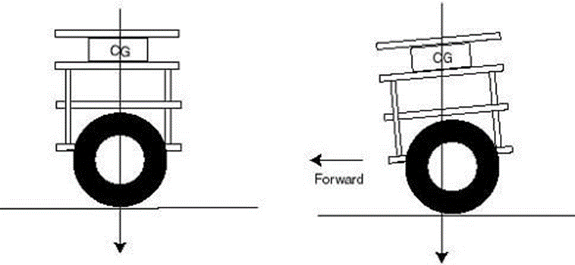
INTRODUCTION
Two-wheeled self-balancing robot is a remarkable example of robotic engineering that imitate human balance and movement.
Self-balancing robot is based on the principle of Inverted pendulum, which is a two wheel vehicle balances itself up in the vertical position with reference to the ground.

Slide 6

OBJECTIVE
Basic understanding of mobile robot concepts
Applying learned theory for further projects
Understand the research and design processes of a system
Applying MATLAB and SIMULINK

Slide 7
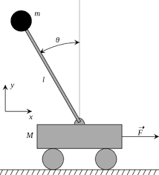
OVERVIEW
This section provides an insight and literature review for the current technology available to build a two-wheel self-balancing robot. It also highlights the different methods used by studies on this project
The balancing robot concept is based on the inverted pendulum model
One of the most widely used controllers is the proportional derivative integral controller, also known as the PID controller

Slide 8

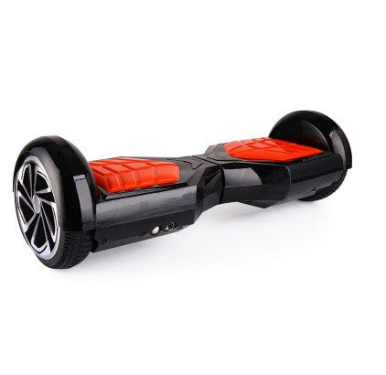
Application
Self balancing scooter

Slide 9
02
Theorical basic

Slide 10
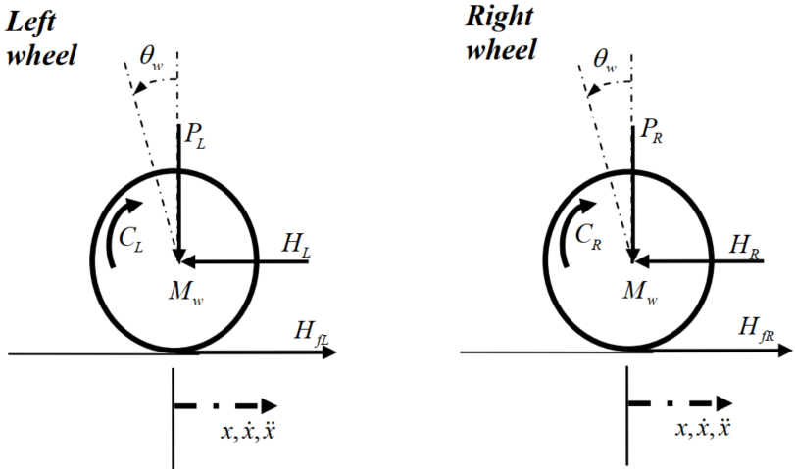
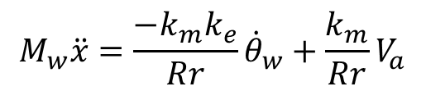
Wheels dynamics equation
$$M_{w}\ddot{x}=\frac{{−k}_{m}k_{e}}{Rr}{\dot{θ}}_{w}+\frac{k_{m}}{Rr}V_{a}$$
https://www.researchgate.net/publication/347919405_DIEU_KHIEN_HE_CON_LAC_NGUOC_DUNG_PID_KET_HOP_TUYEN_TINH_HOA_VAO-RA

Slide 11
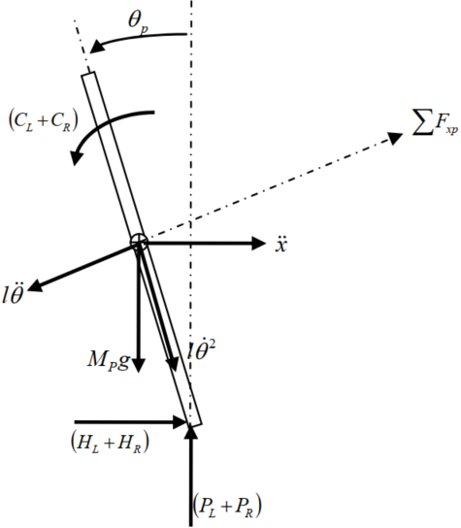
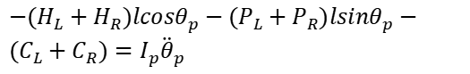
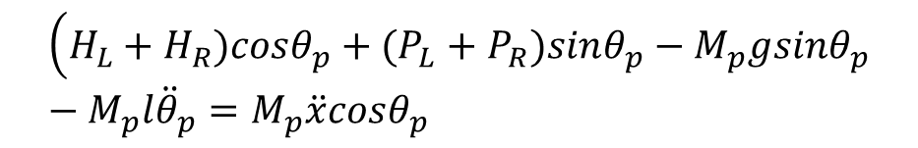
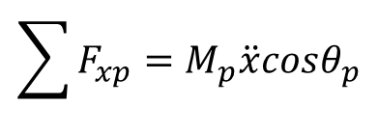
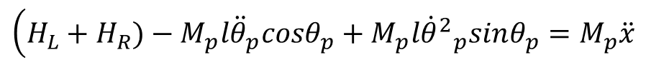
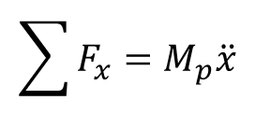
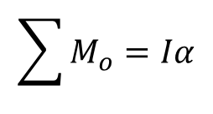
Pendulum dynamics equation
$$\sum{F_{x}=M_{p}\ddot{x}}$$
$$\left(H_{L}+H_{R})−M_{p}l{\ddot{θ}}_{p}cosθ_{p}+M_{p}l{{\dot{θ}}^{2}}_{p}sinθ_{p}=M_{p}\ddot{x}\right.$$
$$\sum{F_{xp}=M_{p}\ddot{x}cosθ_{p}}$$
$$\left(H_{L}+H_{R})cosθ_{p}+(P_{L}+P_{R})sinθ_{p}−M_{p}gsinθ_{p}−M_{p}l{\ddot{θ}}_{p}=M_{p}\ddot{x}cosθ_{p}\right.$$
$$\sum{M_{o}=Iα}$$
$−(H_{L}+H_{R})lcosθ_{p}−(P_{L}+P_{R})lsinθ_{p}−(C_{L}+C_{R})=I_{p}{\ddot{θ}}_{p}$
https://www.researchgate.net/publication/347919405_DIEU_KHIEN_HE_CON_LAC_NGUOC_DUNG_PID_KET_HOP_TUYEN_TINH_HOA_VAO-RA

Slide 12
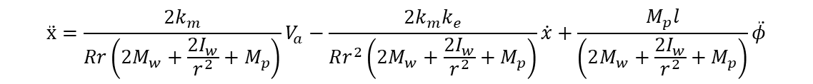
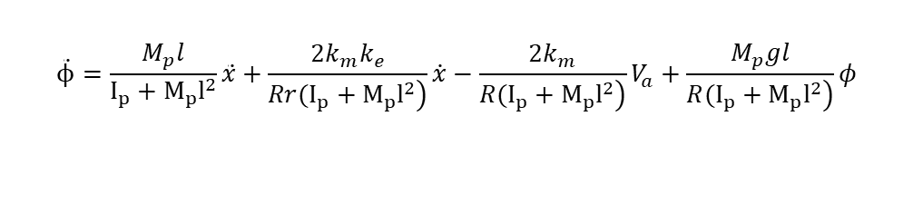
State-space model of the system
$$\ddot{ϕ}=\frac{M_{p}l}{I_{p}+M_{p}l^{2}}\ddot{x}+\frac{{2k}_{m}k_{e}}{\left.Rr(I_{p}+M_{p}l^{2}\right)}\dot{x}−\frac{{2k}_{m}}{\left.R(I_{p}+M_{p}l^{2}\right)}V_{a}+\frac{M_{p}gl}{\left.R(I_{p}+M_{p}l^{2}\right)}φ$$
$$\ddot{x}=\frac{{2k}_{m}}{Rr\left(2M_{w}+\frac{2I_{w}}{r^{2}}+M_{p}\right)}V_{a}−\frac{{2k}_{m}k_{e}}{Rr^{2}\left(2M_{w}+\frac{2I_{w}}{r^{2}}+M_{p}\right)}\dot{x}+\frac{M_{p}l}{\left(2M_{w}+\frac{2I_{w}}{r^{2}}+M_{p}\right)}\ddot{φ}$$

Slide 13
Simulation
03

Slide 14
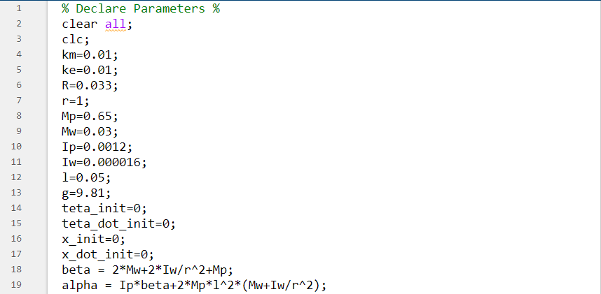
DECLARE PARAMETER IN MATLAB

Slide 15
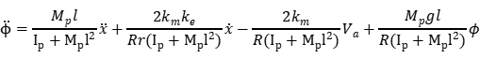
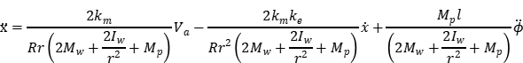
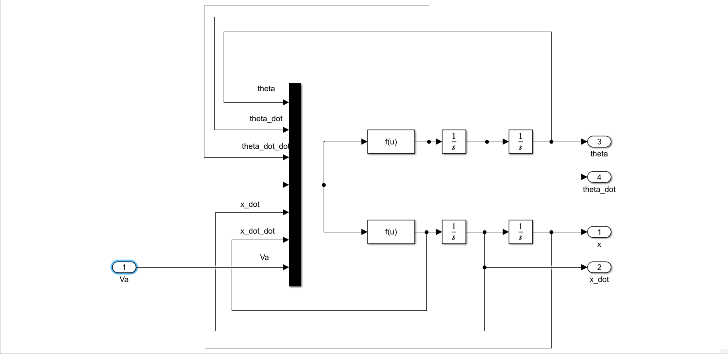
MODEL IN MATLAB/SIMULINK
Model of Self balancing robot based on state-space equation

Slide 16
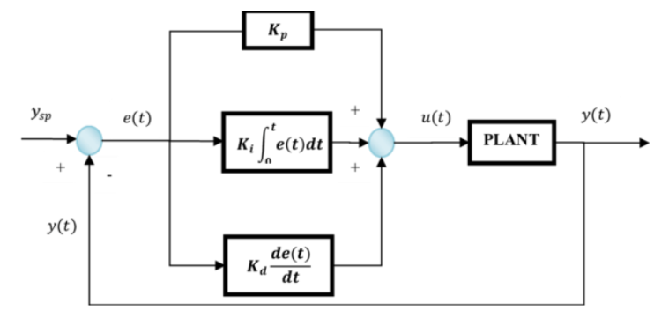
PID
https://mesidas.com/pid/

Slide 17
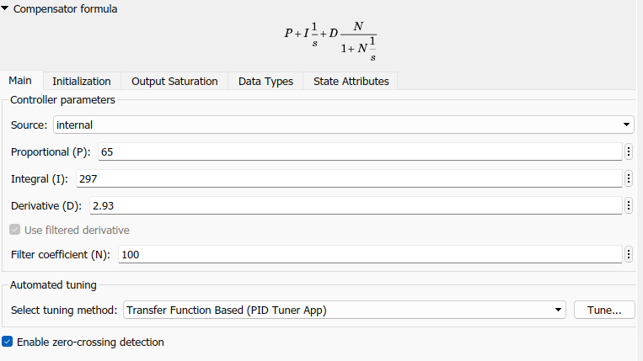
PID parameters

Slide 18
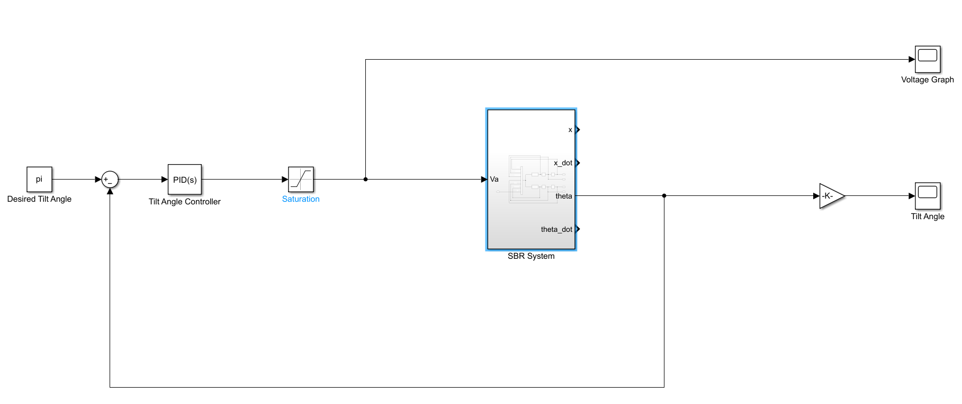
MODEL IN MATLAB/SIMULINK
Model of the system

Slide 19
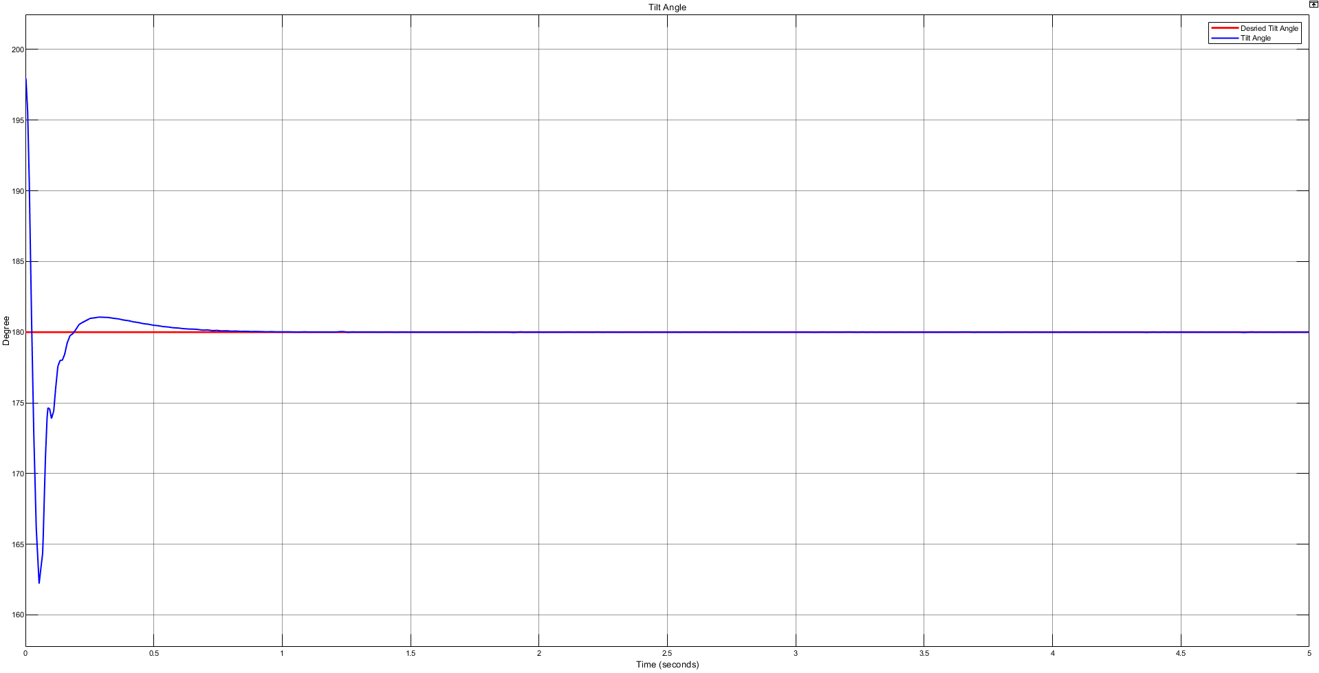
Tilt angle graph

Slide 20
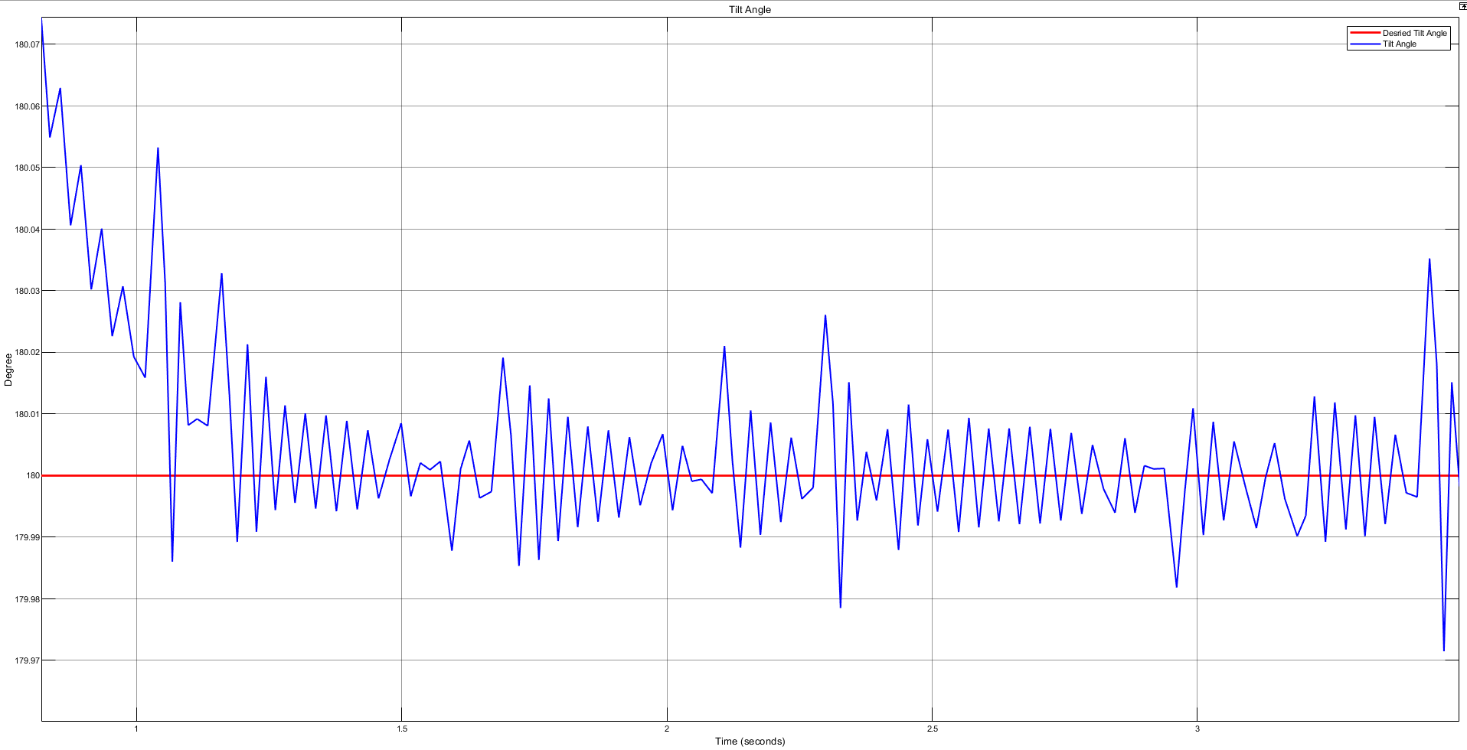
Tilt angle graph when zoom in

Slide 21
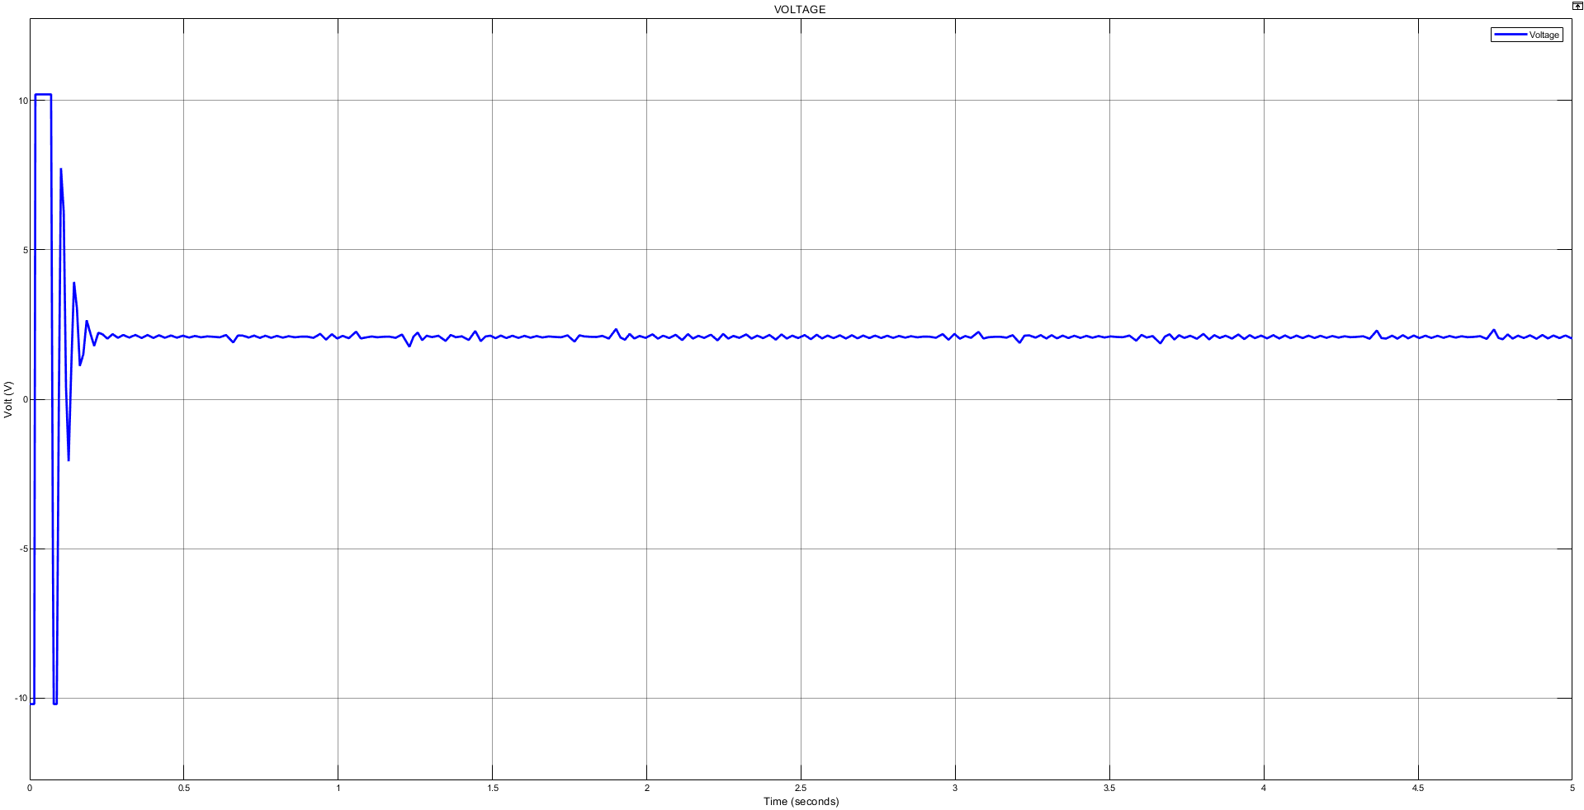
Voltage graph

Slide 22
EXPERIMENT
04
4.1 Component
4.2 Circuit diagram
4.4 Actual product
4.4 Programming

Slide 23
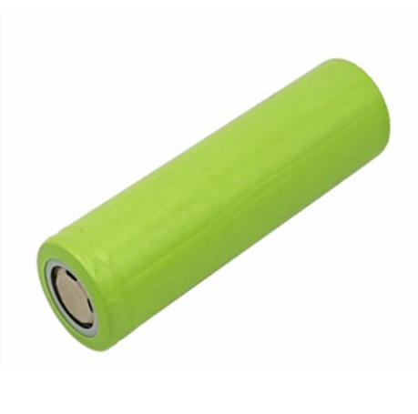
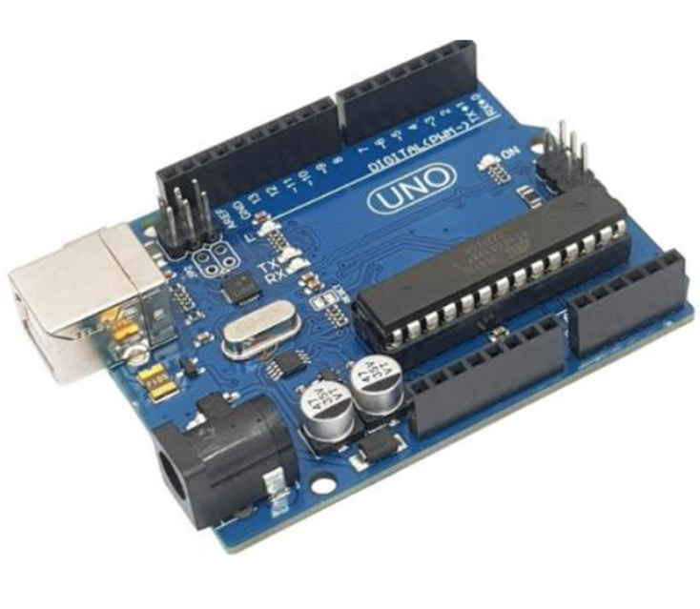
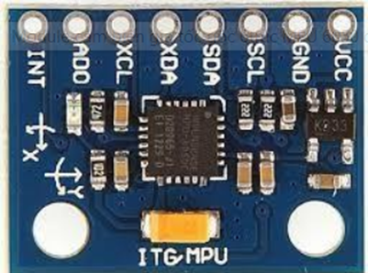
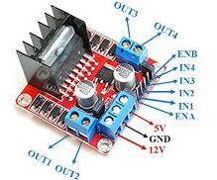
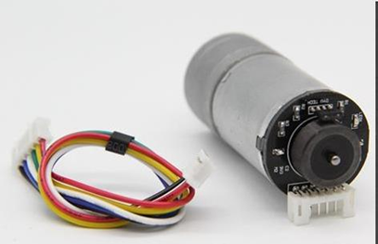
COMPONENT
Battery
Arduino UNO
MPU 6050
Module L298N
Motor 25GA370

Slide 24
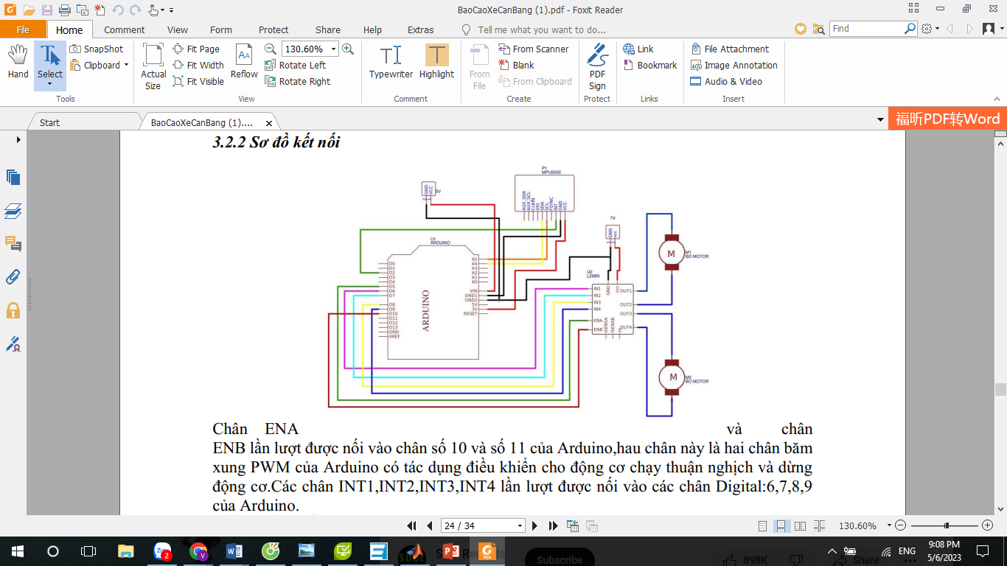
CIRCUIT DIAGRAM
Control the direction of rotation of the Arduino:
When ENA = 0: Motor does not rotate.
When ENA = 1:
a. INT1 = 1; INT2 = 0: motor rotates forward.
b. INT1 = 0; INT2 = 1: the motor rotates backward.
c. INT1 = INT2: motor stops immediately. (same with pins ENB, INT3, INT4).

Slide 25
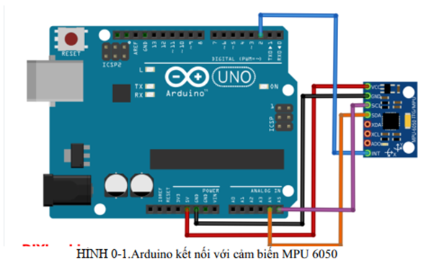
MPU6050 sensor uses I2C interface to communicate with Arduino board through 2 pins SDA and SCL respectively with pins A5 (SCL) and A4 (SDA) of arduino.
The sensor's interrupt pin is connected to the Arduino's interrupt pin 2, when the vehicle is tilted, it means an interrupt occurs, the program will now prioritize interrupts to help the car operate more stable.

Slide 26
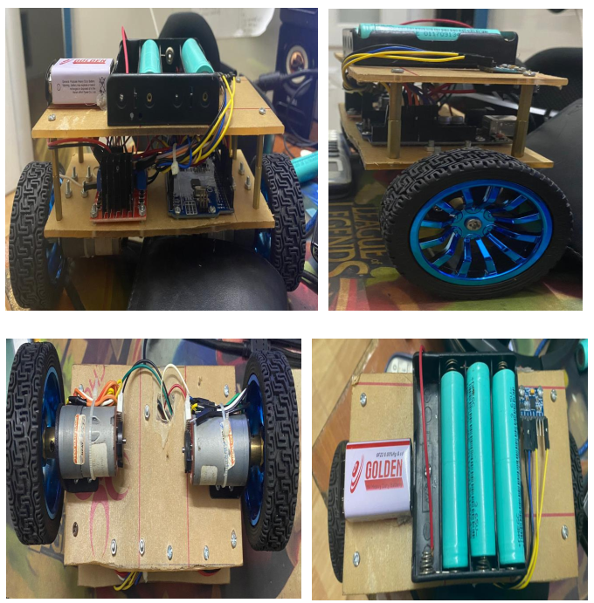
Actual product

Slide 27
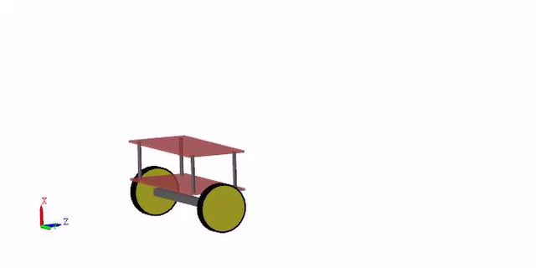
Simulation

Slide 28
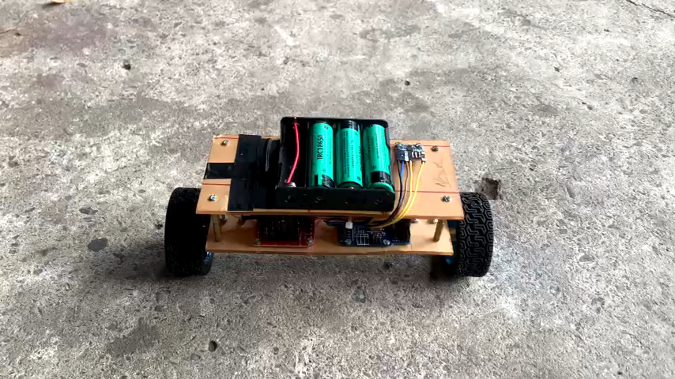

Slide 29
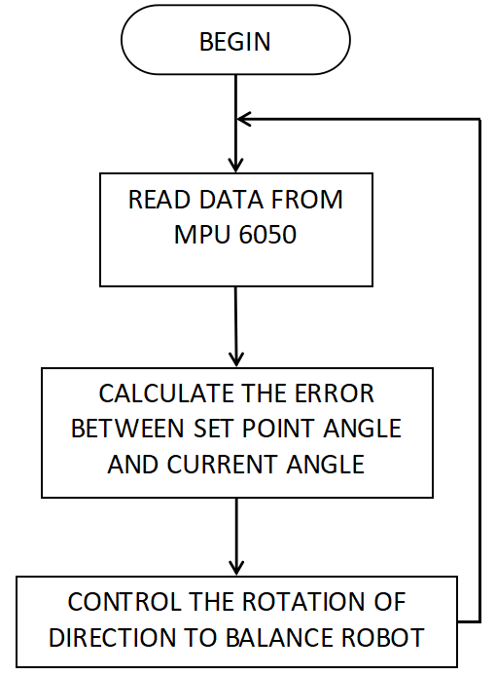
PROGRAMMING
Flow chart

Slide 30
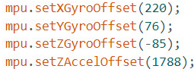
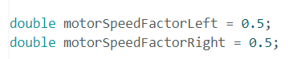
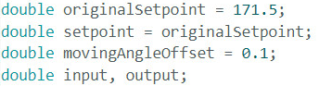
Gyroscope Offset
Motor speed Factor
Setup point

Slide 31
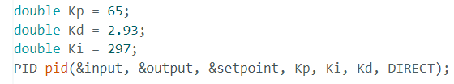
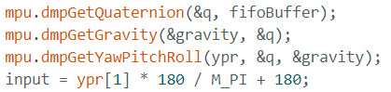
Setup PID
Tilt angle calculation

Slide 32
05
conclusion
5.1 Results achieved
5.2 Limitation
5.3 Conclusion

Slide 33
Results achived
Electrical components and microcontroller work well
Setup a mathematical model of robot and successfully simulate the model on Matlab Simulink.
Complete design self-balancing two wheel robot model
The model can keep its balance in place

Slide 34
Limitation
Only balancing in place without moving
The balance is not so good, it is easy to overshot
The system does not respond when the coefficient of friction and mass M of the robot is changed

Slide 35
Conclusion
Two wheel self-balancing robot is a challenging topic. Designing a two wheeled self-balancing robot model more complete, flexible model and as a basis for building a self-balancing robot that can carry people, it is necessary to accurately calculate the mechanical structure, accurate parameters about motors, encoders, sensors.
Know about PID control to and how to setup the parameter for optimize the performance for the system.

Slide 36

Do you have any questions ?

